Slide 1
Newton’s method

Slide 2
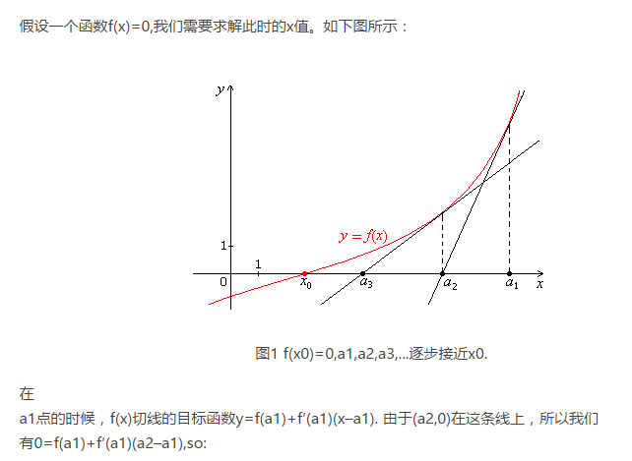
a2=a1-f(a1)/f’(a1)

Slide 3
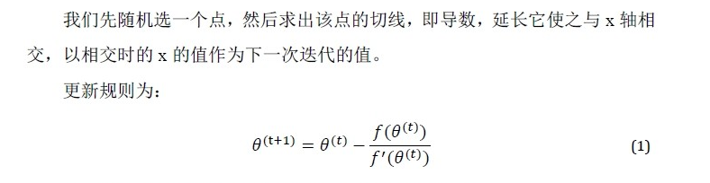


Slide 4
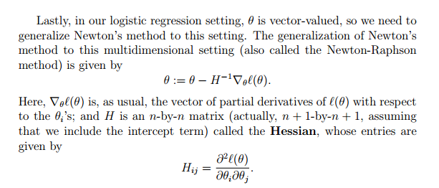

Slide 5
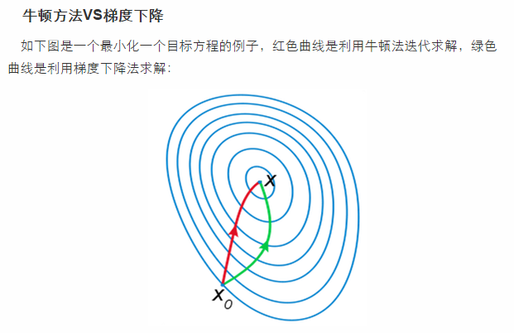
迭代到距离收敛值比较近的时候，每次迭代都能使误差变为原来的平方。

Slide 6
Newton’s method typically enjoys faster convergence than (batch) gradient descent, and requires many fewer iterations to get very close to theminimum.
One iteration of Newton’s can, however, be more expensive than one iteration of gradient descent, since it requires finding and inverting an n-by-n Hessian; but so long as n is not too large, it is usually much faster overall.
When Newton’s method is applied to maximize the logistic regression log likelihood function ℓ(θ), the resulting method is also called Fisher scoring.

